Slide 1
Chapter 17:
Distributed Systems

Slide 2
Chapter 17: Distributed Systems
Advantages of Distributed Systems
Types of Network-Based Operating Systems
Network Structure
Communication Structure
Communication Protocols
An Example: TCP/IP
Robustness
Design Issues
Distributed File System

Slide 3
Chapter Objectives
To provide a high-level overview of distributed systems and the networks that interconnect them
To discuss the general structure of distributed operating systems
To explain general communication structure and communication protocols
To describe issues concerning the design of distributed systems

Slide 4

Overview
Distributed system is collection of loosely coupled processors interconnected by a communications network
Processors variously called nodes, computers, machines, hosts
  Site is location of the processor
  Generally a server has a resource a client node at a different site wants to use

Slide 5
Reasons for Distributed Systems
Reasons for distributed systems
  Resource sharing
    Sharing and printing files at remote sites
    Processing information in a distributed database
    Using remote specialized hardware devices
  Computation speedup – load sharing or job migration
  Reliability – detect and recover from site failure, function transfer, reintegrate failed site
  Communication – message passing

Slide 6
New Problems Created
Security
  How to protect private data
  How to protect resources
Increased System Software Complexity
  More difficult to coordinate and synchronize processes
  More difficult to share resources
Increased cost of failures
  If one computer serving many distributed users fails
Increased Hardware complexity
  Communication is now part of the computing processes

Slide 7
Types of Distributed Operating Systems
Network Operating Systems
Distributed Operating Systems

Slide 8
Network-Operating Systems
Users are aware of multiplicity of machines
Access to resources of various machines is done explicitly by:
  Remote logging into the appropriate remote machine (telnet, ssh)
  Transferring data from remote machines to local machines, via the File Transfer Protocol (FTP) mechanism

Slide 9
Distributed-Operating Systems
Users not aware of multiplicity of machines
  Access to remote resources similar to access to local resources
Data Migration – transfer data by transferring entire file, or transferring only those portions of the file necessary for the immediate task
Computation Migration – transfer the computation, rather than the data, across the system
  Via remote procedure calls (RPCs)
  or via messaging system

Slide 10
Distributed-Operating Systems (Cont.)
Process Migration – execute an entire process, or parts of it, at different sites
  Load balancing – distribute processes across network to even the workload
  Computation speedup – subprocesses can run concurrently on different sites
  Hardware preference – process execution may require specialized processor
  Software preference – required software may be available at only a particular site
  Data access – run process remotely, rather than transfer all data locally

Slide 11
Network Structure
Local-Area Network (LAN) – designed to cover small geographical area
  Multiple topologies like star or ring
  Speeds from 1Mb per second (Appletalk, bluetooth) to 40 Gbps for fastest Ethernet over twisted pair copper or optical fibre
  Nodes:
    usually workstations and/or personal computers
    a few (usually one or two) mainframes
  Ethernet most common way to construct LANs
    Multiaccess bus-based
    Defined by standard IEEE 802.3
  Wireless spectrum (WiFi) increasingly used for networking
    I.e. IEEE 802.11g standard implemented at 54 Mbps

Slide 12
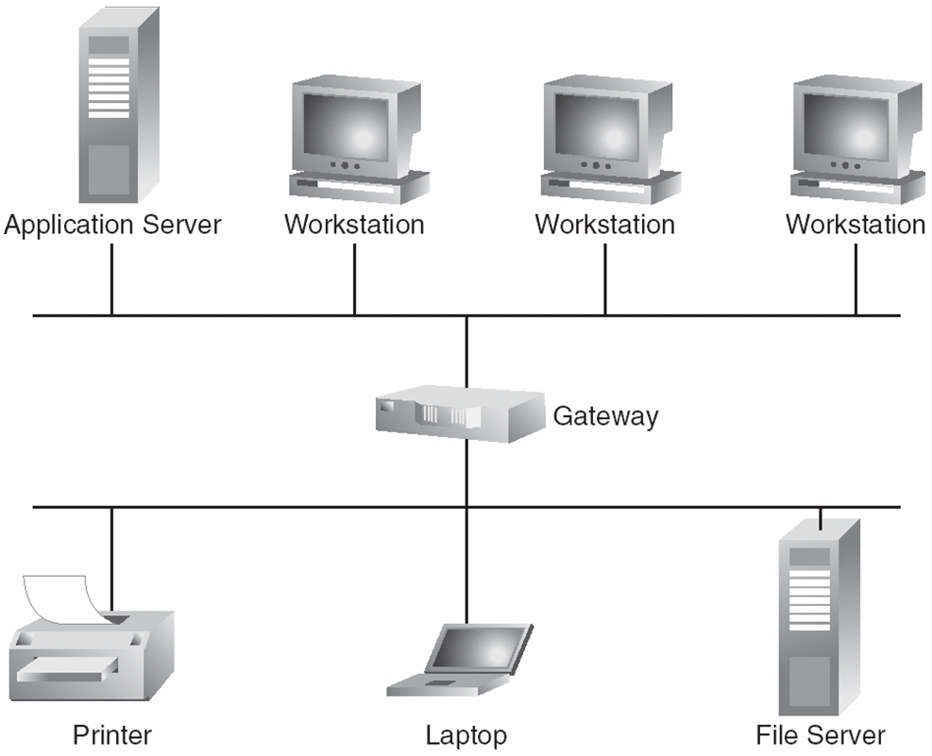
Local-area Network

Slide 13
Network Types (Cont.)
Wide-Area Network (WAN) – links geographically separated sites
  Point-to-point connections over long-haul lines (often leased from a phone company)
    Implemented via connection processors known as routers
  Speeds
    T1 link is 1.544 Megabits per second
    T3 is 28 x T1s = 45 Mbps
    OC-12 is 622 Mbps
  Broadcast usually requires multiple messages
  Nodes:
    usually a high percentage of mainframes
  WANs and LANs interconnect, similar to cell phone network:
    Cell phones use radio waves to cell towers
    Towers connect to other towers and hubs

Slide 14
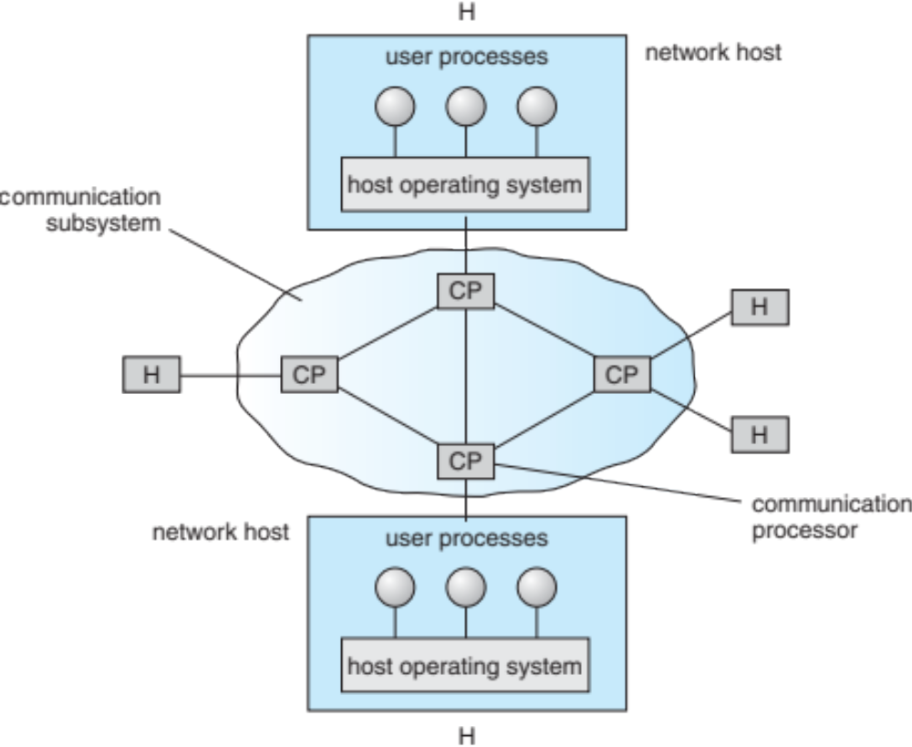
Communication Processors in a Wide-Area Network

Slide 15
Network Topology
Sites in the system can be physically connected in a variety of ways; they are compared with respect to the following criteria:
  Installation cost - How expensive is it to link the various sites in the system?
  Communication cost - How long does it take to send a message from site A to site B?
  Reliability - If a link or a site in the system fails, can the remaining sites still communicate with each other?
The various topologies are depicted as graphs whose nodes correspond to sites
  An edge from node A to node B corresponds to a direct connection between the two sites
The following six items depict various network topologies

Slide 16
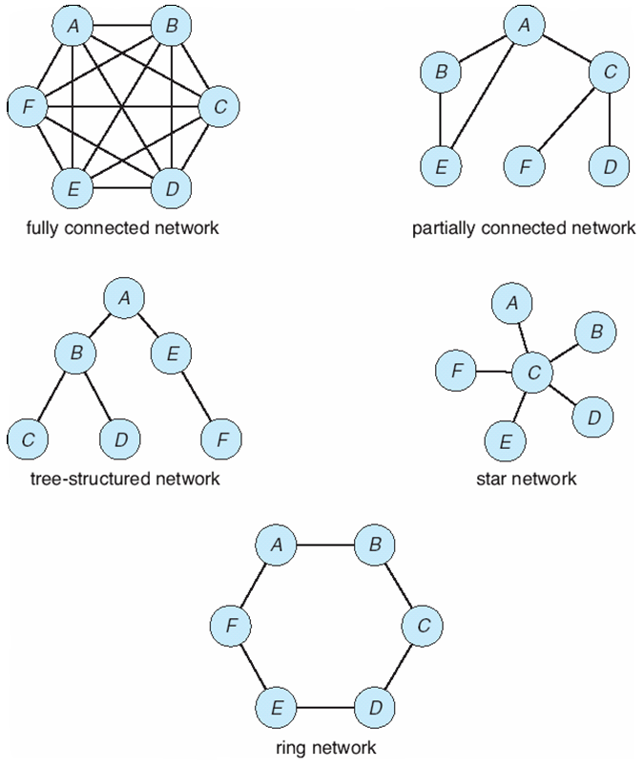
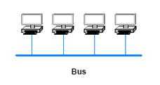
Network Topology

Slide 17
Communication Structure
The design of a communication network must address four basic issues:
Naming and name resolution - How do two processes locate each other to communicate?
Routing strategies - How are messages sent through the network?
Connection strategies - How do two processes send a sequence of messages?
Contention - The network is a shared resource, so how do we resolve conflicting demands for its use?

Slide 18
Naming and Name Resolution
Name systems in the network
Address messages with the process-id
Identify processes on remote systems by
      <host-name, identifier> pair
Domain name system (DNS) – specifies the naming structure of the hosts, as well as name to address resolution (Internet)

Slide 19
Routing Strategies
Fixed routing - A path from A to B is specified in advance; path changes only if a hardware failure disables it
  Since the shortest path is usually chosen, communication costs are minimized
  Fixed routing cannot adapt to load changes
  Ensures that messages will be delivered in the order in which they were sent
Virtual routing- A path from A to B is fixed for the duration of one session. Different sessions involving messages from A to B may have different paths
  Partial remedy to adapting to load changes
  Ensures that messages will be delivered in the order in which they were sent

Slide 20
Routing Strategies (Cont.)
Dynamic routing - The path used to send a message form site A to site B is chosen only when a message is sent
  Usually a site sends a message to another site on the link least used at that particular time
  Adapts to load changes by avoiding routing messages on heavily used path
  Messages may arrive out of order
    This problem can be solved by appending a sequence number to each message
  Most complex to set up
Router is communications processor responsible for routing messages
Tradeoffs mean all methods are used
  UNIX provides ability to mix fixed and dynamic
  Hosts may have fixed routes and gateways connecting networks together may have dynamic routes

Slide 21
Routing Strategies (Cont.)
More recently, routing managed by software more intelligently than routing protocols
  OpenFlow is device-independent, allowing developers to introduce network efficiencies by decoupling data-routing decisions from underlying network devices
Messages vary in length – simplified design breaks them into packets (or frames, or datagrams)
Connectionless message is just one packet
  Otherwise need a connection to get a multi-packet message from source to destination

Slide 22
Connection Strategies
Circuit switching - A permanent physical link is established for the duration of the communication (i.e., telephone system)
Message switching - A temporary link is established for the duration of one message transfer (i.e., post-office mailing system)
Packet switching - Messages of variable length are divided into fixed-length packets which are sent to the destination
  Each packet may take a different path through the network
  The packets must be reassembled into messages as they arrive
Circuit switching requires setup time, but incurs less overhead for shipping each message, and may waste network bandwidth
  Message and packet switching require less setup time, but incur more overhead per message

Slide 23
Contention
Several sites may want to transmit information over a link simultaneously. Techniques to avoid repeated collisions include:
CSMA/CD - Carrier sense with multiple access (CSMA); collision detection (CD)
  A site determines whether another message is currently being transmitted over that link. If two or more sites begin transmitting at exactly the same time, then they will register a CD and will stop transmitting
  When the system is very busy, many collisions may occur, and thus performance may be degraded
  CSMA/CD is used successfully in the Ethernet system, the most common network system

Slide 24
Contention (Cont.)
Token passing - A unique message type, known as a token, continuously circulates in the system (usually a ring structure)
  A site that wants to transmit information must wait until the token arrives
  When the site completes its round of message passing, it retransmits the token
  A token-passing scheme is used by some IBM and HP/Apollo systems
Message slots - A number of fixed-length message slots continuously circulate in the system (usually a ring structure)
  Since a slot can contain only fixed-sized messages, a single logical message may have to be broken down into a number of smaller packets, each of which is sent in a separate slot
  This scheme has been adopted in the experimental Cambridge Digital Communication Ring

Slide 25
Communication Protocol
The communication network is partitioned into the following multiple layers:
Layer 1: Physical layer – handles the mechanical and electrical details of the physical transmission of a bit stream
Layer 2: Data-link layer – handles the frames, or fixed-length parts of packets, including any error detection and recovery that occurred in the physical layer
Layer 3: Network layer – provides connections and routes packets in the communication network, including handling the address of outgoing packets, decoding the address of incoming packets, and maintaining routing information for proper response to changing load levels

Slide 26
Communication Protocol (Cont.)
Layer 4: Transport layer – responsible for low-level network access and for message transfer between clients, including partitioning messages into packets, maintaining packet order, controlling flow, and generating physical addresses
Layer 5: Session layer – implements sessions, or process-to-process communications protocols
Layer 6: Presentation layer – resolves the differences in formats among the various sites in the network, including character conversions, and half duplex/full duplex (echoing)
Layer 7: Application layer – interacts directly with the users, deals with file transfer, remote-login protocols and electronic mail, as well as schemas for distributed databases

Slide 27
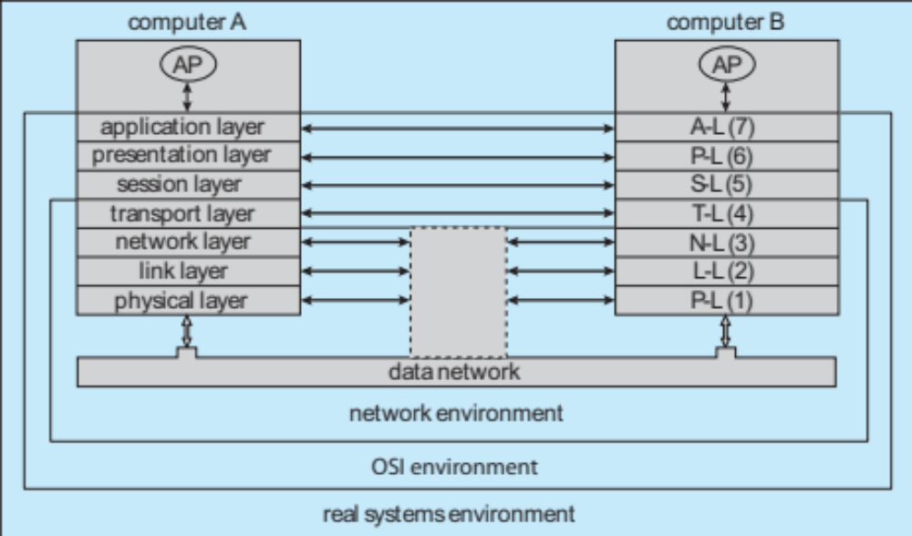
Communication Via ISO Network Model

Slide 28
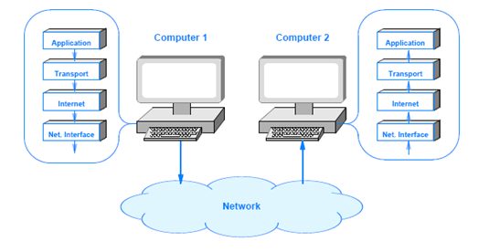
The TCP/IP Protocol Layers

Slide 29
Robustness
Failure detection
Reconfiguration

Slide 30
Failure Detection
Detecting hardware failure is difficult
To detect a link failure, a heartbeat protocol can be used
Assume Site A and Site B have established a link
  At fixed intervals, each site will exchange an I-am-up message indicating that they are up and running
If Site A does not receive a message within the fixed interval, it assumes either (a) the other site is not up or (b) the message was lost
Site A can now send an Are-you-up? message to Site B
If Site A does not receive a reply, it can repeat the message or try an alternate route to Site B

Slide 31
Failure Detection (Cont.)
If Site A does not ultimately receive a reply from Site B, it concludes some type of failure has occurred
Types of failures:
- Site B is down
- The direct link between A and B is down
- The alternate link from A to B is down
- The message has been lost
However, Site A cannot determine exactly why the failure has occurred

Slide 32
Reconfiguration
When Site A determines a failure has occurred, it must reconfigure the system:
  If the link from A to B has failed, this must be broadcast to every site in the system
  If a site has failed, every other site must also be notified indicating that the services offered by the failed site are no longer available
When the link or the site becomes available again, this information must again be broadcast to all other sites

Slide 33
Design Issues
Transparency – the distributed system should appear as a conventional, centralized system to the user
Fault tolerance – the distributed system should continue to function in the face of failure
Scalability – as demands increase, the system should easily accept the addition of new resources to accommodate the increased demand
Clusters – a collection of semi-autonomous machines that acts as a single system

Slide 34
Distributed File System
Distributed file system (DFS) – a distributed implementation of the classical time-sharing model of a file system, where multiple users share files and storage resources
A DFS manages set of dispersed storage devices
Overall storage space managed by a DFS is composed of different, remotely located, smaller storage spaces
There is usually a correspondence between constituent storage spaces and sets of files
Challenges include:
  Naming and Transparency
  Remote File Access

Slide 35
DFS Structure
Service – software entity running on one or more machines and providing a particular type of function to a priori unknown clients
Server – service software running on a single machine
Client – process that can invoke a service using a set of operations that forms its client interface
A client interface for a file service is formed by a set of primitive file operations (create, delete, read, write)
Client interface of a DFS should be transparent, i.e., not distinguish between local and remote files

Slide 36
Client/Server Model of Distributed System
Based on a REQUEST – REPLY mechanism
  Client sends a message requesting a service send (server_id, message)
  Server replies with a message that contains the information requested by the client
  send (client_id, result)

Slide 37
Client/Server Model for Distributed System
Local computer Remote computer
Send (server_id, message)
Client blocked until message sent
Receive (server_id, result)
Client blocked until result received
Client processes result
Receive (client_id, message)
Server blocked until message sent
Appropriate procedure called to perform action requested by message
Send (client_id, result)
Go back to step 1

Slide 38
Client/Server Design Alternatives
Non-blocking calls
  After a process makes a send or receive call to the OS, process can continue executing without waiting for the OS to complete the request
  Advantage: faster execution
Blocking calls
  After a process makes a send or receive call to the OS, process is blocked waiting for the OS to complete the request
  Advantage: message buffer is automatically protected

Slide 39
Client/Server Design Alternatives
Unbuffered Messages
  Advantage: reduced OS overhead
Buffered Messages
  A mailbox with several message slots is available
  Advantage: strict timing between client and server is not required
Unreliable Communication
  No guarantees that message is delivered
  Advantage: reduced overhead
Reliable Communication
  Receiving OS acknowledges to sender OS that message was received
  Advantage: a lost message can be resent

Slide 40
Remote Procedure Calls in Distributed system
All information needed by the procedure has to be in the argument list
  No shared memory
  No global variables
This method emphasizes distributed procedure execution

Slide 41
Remote Procedure Calls in Distributed system
Local computer
Procedure B stub
parameters
Calls procedure “B”
Packs parameters into a message
Calls kernel to send a message
Calls kernel to receive a message
Block-waits until it receives reply
Unpacks results
Returns results to the process A and unblocks
OS
K
E
R
N
E
L
Process A
Results from
procedure “B”
results

Slide 42
Remote Procedure Calls in Distributed system
Remote computer
Procedure B stub
parameters
Calls procedure “B”
OS
K
E
R
N
E
L
Block-waits until it receives a message
Unpacks parameters in a message
Calls the procedure B
Block-waits until it receives reply
Packs results into a message
Calls kernel to send a message and unblocks
Procedure B
results
Results from
procedure “B”

Slide 43
Naming Structures
Location transparency – file name does not reveal the file’s physical storage location
Location independence – file name does not need to be changed when the file’s physical storage location changes

Slide 44
Naming Schemes — Three Main Approaches
Files named by combination of their host name and local name; guarantees a unique system-wide name
Attach remote directories to local directories, giving the appearance of a coherent directory tree; only previously mounted remote directories can be accessed transparently
Total integration of the component file systems
  A single global name structure spans all the files in the system
  If a server is unavailable, some arbitrary set of directories on different machines also becomes unavailable

Slide 45
Remote File Access
Remote-service mechanism is one transfer approach
Reduce network traffic by retaining recently accessed disk blocks in a cache, so that repeated accesses to the same information can be handled locally
  If needed data not already cached, a copy of data is brought from the server to the user
  Accesses are performed on the cached copy
  Files identified with one master copy residing at the server machine, but copies of (parts of) the file are scattered in different caches
  Cache-consistency problem – keeping the cached copies consistent with the master file

Slide 46
Cache Location – Disk vs. Main Memory
Advantages of disk caches
  More reliable
  Cached data kept on disk are still there during recovery and don’t need to be fetched again
Advantages of main-memory caches:
  Permit workstations to be diskless
  Data can be accessed more quickly
  Performance speedup in bigger memories
  Server caches (used to speed up disk I/O) are in main memory regardless of where user caches are located; using main-memory caches on the user machine permits a single caching mechanism for servers and users

Slide 47
Cache Update Policy
Write-through – write data through to disk as soon as they are placed on any cache
  Reliable, but poor performance
Delayed-write (write-back) – modifications written to the cache and then written through to the server later
  Write accesses complete quickly; some data may be overwritten before they are written back, and so need never be written at all
  Poor reliability; unwritten data will be lost whenever a user machine crashes
  Variation – scan cache at regular intervals and flush blocks that have been modified since the last scan
  Variation – write-on-close, writes data back to the server when the file is closed
    Best for files that are open for long periods and frequently modified

Slide 48
Consistency
Is locally cached copy of the data consistent with the master copy?
Client-initiated approach
  Client initiates a validity check
  Server checks whether the local data are consistent with the master copy
Server-initiated approach
  Server records, for each client, the (parts of) files it caches
  When server detects a potential inconsistency, it must react

Slide 49
End of Chapter 17

